Slide 1
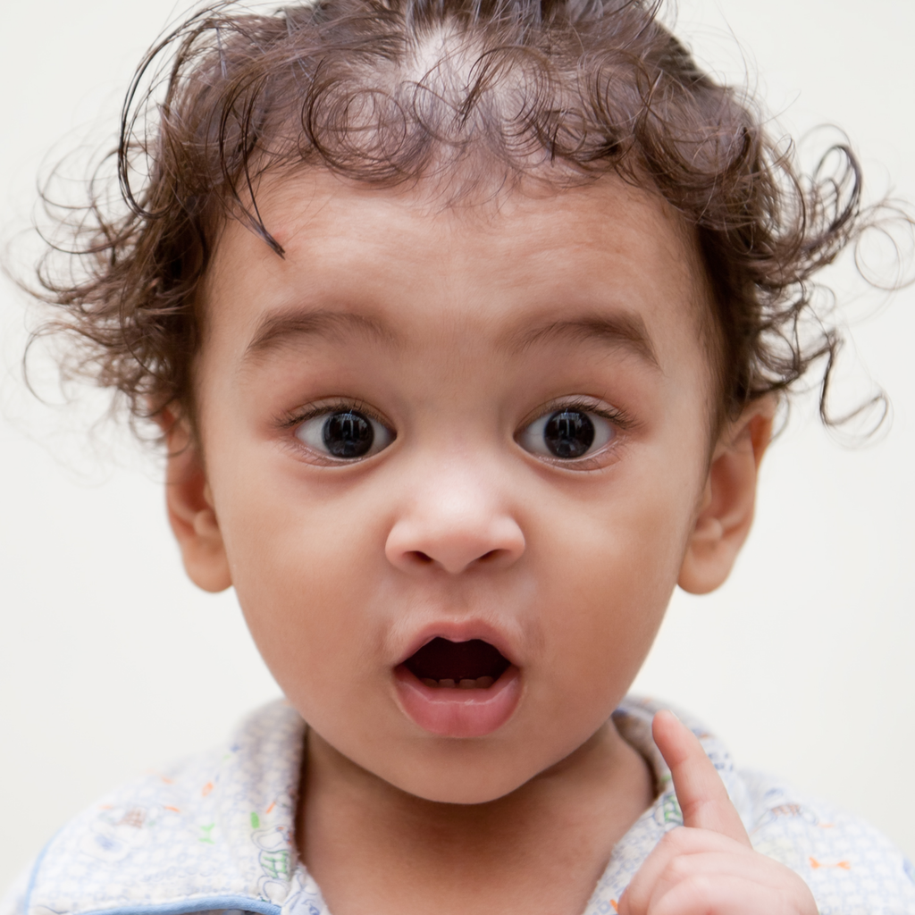

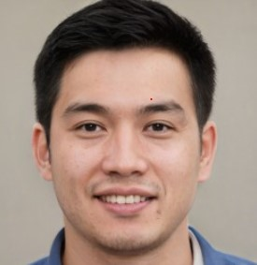
VisionLab
(Facial Images Generator & Detector)
Group 02, Team Members: YIN Tian Shi, YANG Lu Yi, YU Yu
Notes:
NOTE: To replace a picture, just select and delete it. Then use the Insert Picture icon to replace it with one of your own!

Slide 2
Agenda
Project Objectives and Values
Project Scope
Data Sources
Technical Approach
Overall System Design
Model & Process Design
Further Enhancement
Progress Updates

Slide 3
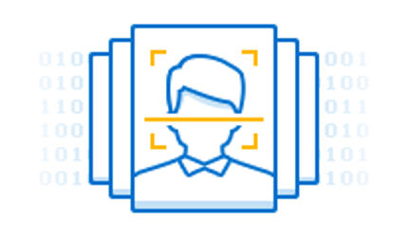
Project Objectives
Out of interest, we designed an intelligent system with following functionalities.
Facial Images Generator
Produce colorful virtual/ fake human and cartoon faces.
Facial Images Detector
Determine the authenticity of human faces that users uploading.
Automated system with intuitive web UI
Users without technical background can use the system.
Model evolves while user data accumulates in system.

Slide 4


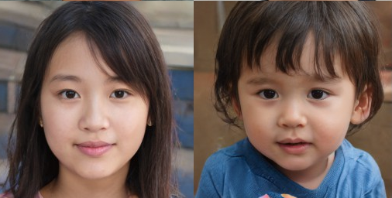
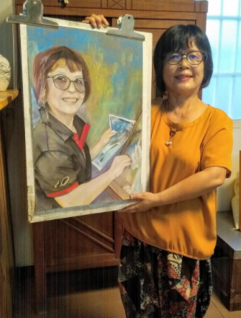



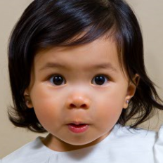
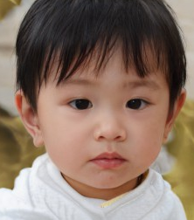
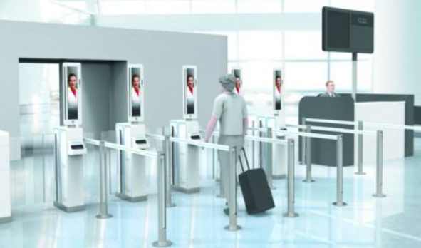
What’s the value about Face Generator & Detector?
Hello,
we were drawn by a computer…
Our family members have many people with different Sex, Age, Ethnicity, Eye and Hair colors etc.
Face Generator
No face copyright issues
Save budget on photo shoots
Balance faces of different groups
Help artists to portray the ultimate fantasy
Draw exclusive cartoon avatars for everyone
Source: http://www.seeprettyface.com/mydataset.html
Source: https://udn.com/news/story/7326/4619078
Face Detector
Can you guess where we are from ?
Detect the authenticity of profile pictures
Source: 11st22.com; blog.securemymind.com
ID verification through face detection
Source: http://www.seeprettyface.com/mydataset.html
Source: https://www.chinait.com/ai/3493.html

Slide 5
Business Values
Facial Images Generator
Virtual Human Faces
Provide various types of face materials for customers to use as will and no need to worry about face copyright issues.
Save large budget on expensive photo shoots for artwork and marketing departments, while get enough faces of underrepresented groups to balance media and marketing materials.
Cartoon Faces
Diverse cartoon faces have important artistic and practical values. Since they can help artists to portray the ultimate fantasy for people to see. General speaking, requesting professionals to draw exclusive cartoon avatars for everyone is impractical and limits creativity.
Facial Images Detector
Distinguish dubious use of applications that have brought attention to AI-generated images, such as profile pictures for fake news and dating services.
Verify identity through face detection at the airport, customs and other ID verification scenarios.

Slide 6
Project Scope
Functions / Features | Approaches / Techniques
Virtual Human & Cartoon Facial Images Generator | Unsupervised Learning Generative Adversarial Network (e.g. DCGAN, StyleGAN) Ensemble methods with several models
Virtual (Fake) Facial Images Detector | Supervised Learning Deep Convolutional Neural Network (e.g. VGG, ResNet) Ensemble methods with several models
Model Training Pipeline | Deep Learning pipeline can be automated to train and update generative/ predictive models when fresh images are uploaded. Images produced by the generator can also act as the data source for the fake images detector.
Web UI & REST API | Expose all functions as REST APIs. User interacts with web UI which triggers REST APIs in the background. External system also integrates via REST APIs.

Slide 7
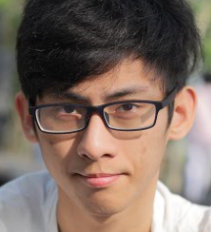
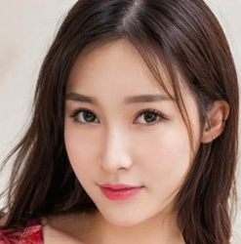

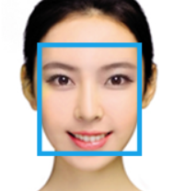
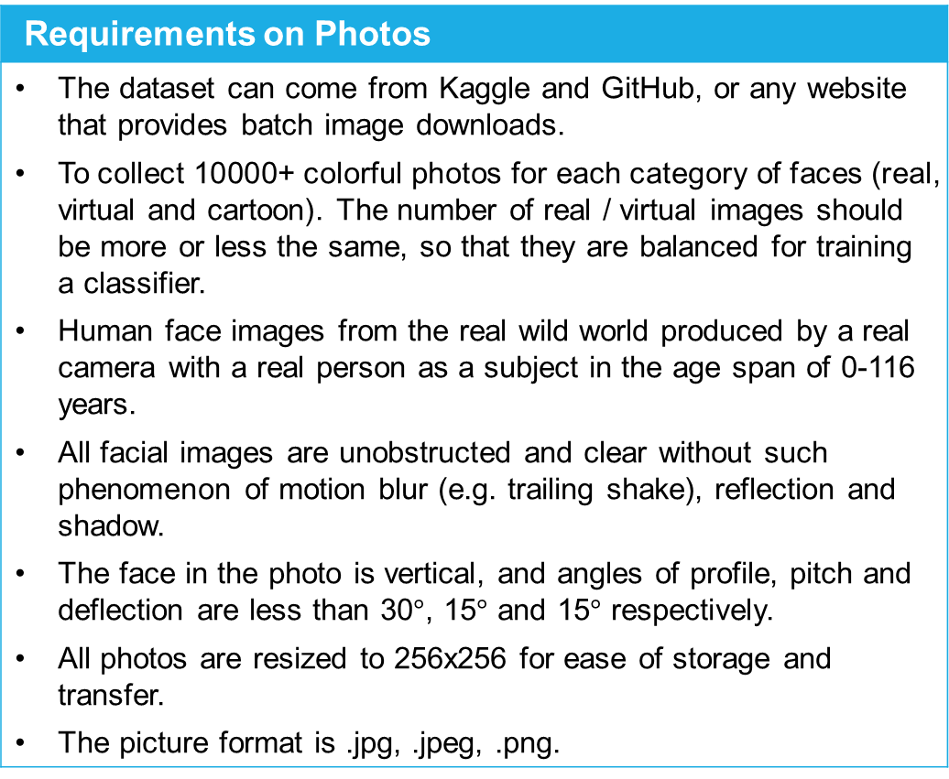
Data Sources
(Facial Photos Datasets )
Requirements on Photos
The dataset can come from Kaggle and GitHub, or any website that provides batch image downloads. To collect 10000+ colorful photos for each category of faces (real, virtual and cartoon). The number of real / virtual images should be more or less the same, so that they are balanced for training a classifier. Human face images from the real wild world produced by a real camera with a real person as a subject in the age span of 0-116 years. All facial images are unobstructed and clear without such phenomenon of motion blur (e.g. trailing shake), reflection and shadow. The face in the photo is vertical, and angles of profile, pitch and deflection are less than 30$°$, 15$°$ and 15$°$ respectively. All photos are resized to 256x256 for ease of storage and transfer. The picture format is .jpg, .jpeg, .png.
Real human faces
256x256, 10000+
Virtual human faces
256x256, 10000+
Cartoon faces
256x256, 10000+
Realtime faces
256x256, (user uploads)
Source: http://www.seeprettyface.com/mydataset.html; http://www.taisau.com/

Slide 8
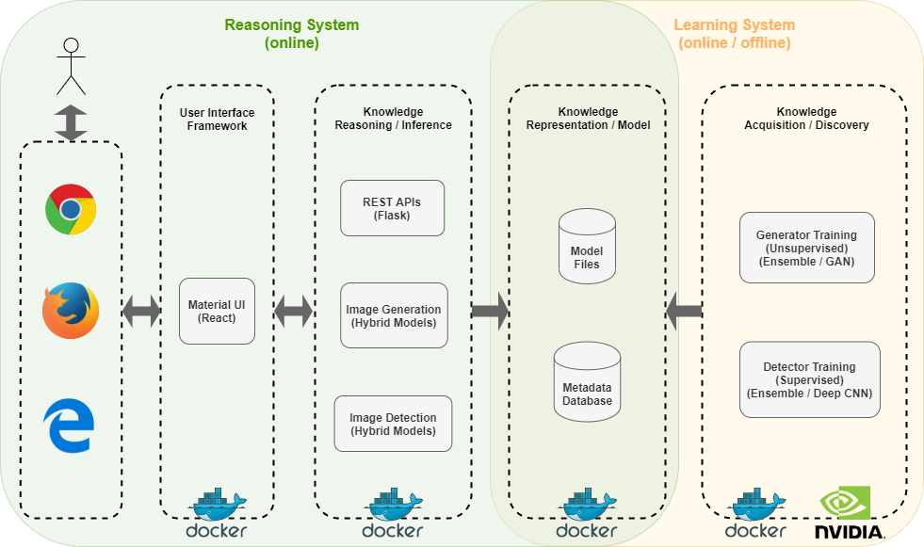
Overall System Design

Slide 9
Overall Process Design
Image Generator
Image Detector
Real Human Faces
Model Trainings
Predict the image is real/ fake
Generate Fake Human Faces
Model Trainings
Generate Cartoon Faces
Cartoon Faces drawn by artists
Note,
The definition of “fake” is that facial photos are AI-generated.
The definition of “real” is that facial photos are produced by camera or artists.

Slide 10
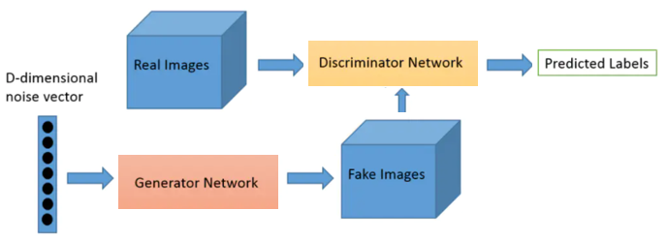
Image Generator – Models (GANs) Page 1/3
Overall Generative Training Flow
DCGAN (Deep Convolutional GAN)
https://arxiv.org/pdf/1511.06434.pdf
https://www.tensorflow.org/tutorials/generative/dcgan
StyleGAN2
https://arxiv.org/pdf/1912.04958.pdf
https://github.com/NVlabs/stylegan2
http://www.seeprettyface.com/mydataset.html
http://www.taisau.com/
https://github.com/a312863063

Slide 11
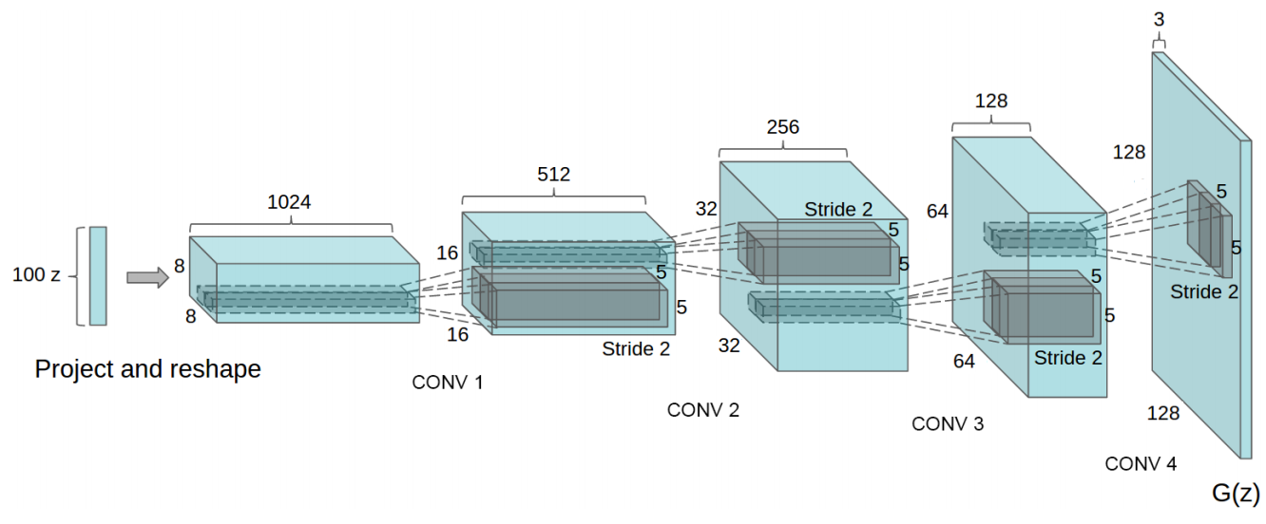
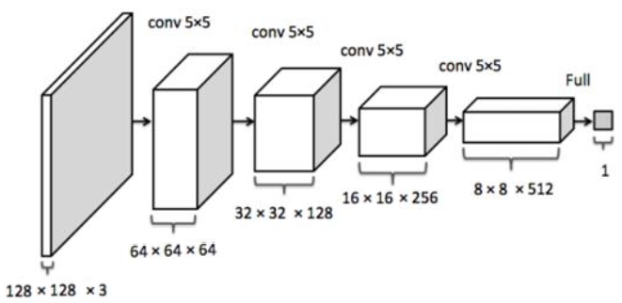
Image Generator – Models (GANs) Page 2/3
DCGAN (Deep Convolutional GAN)
Generator Network
Discriminator Network

Slide 12
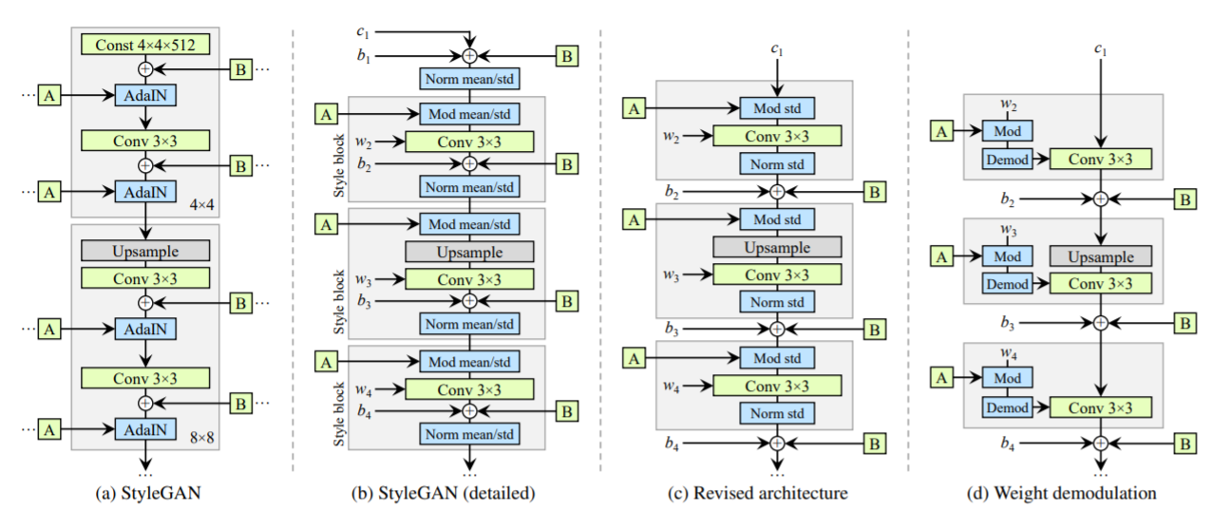
Image Generator – Models (GANs) Page 3/3
StyleGAN2

Slide 13
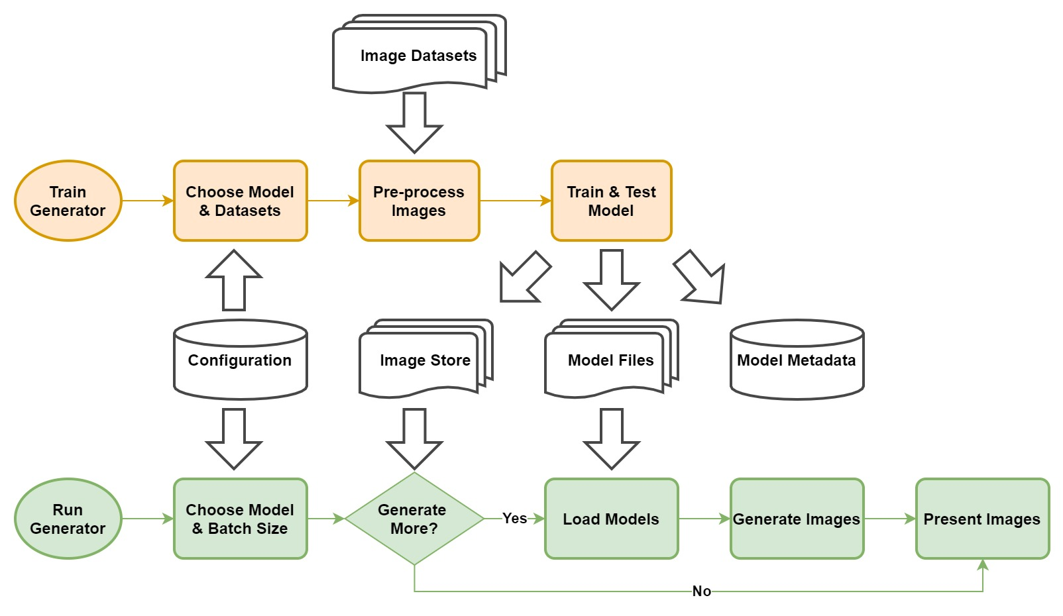
Image Generator – Process Design

Slide 14
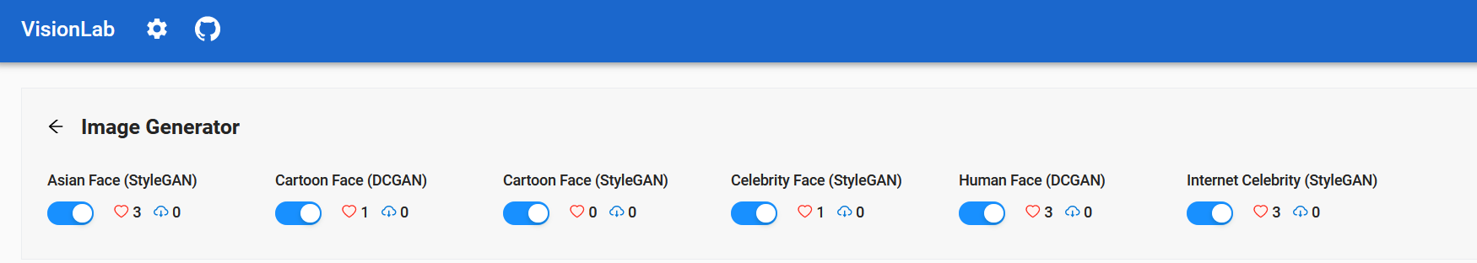
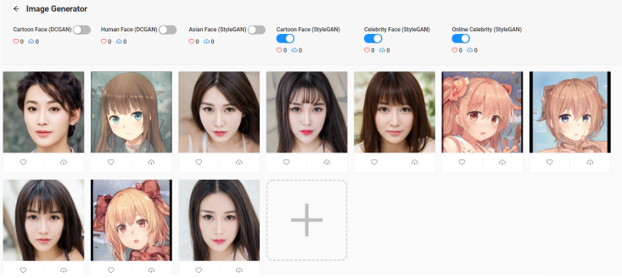
Image Generator – System Deployment

Slide 15
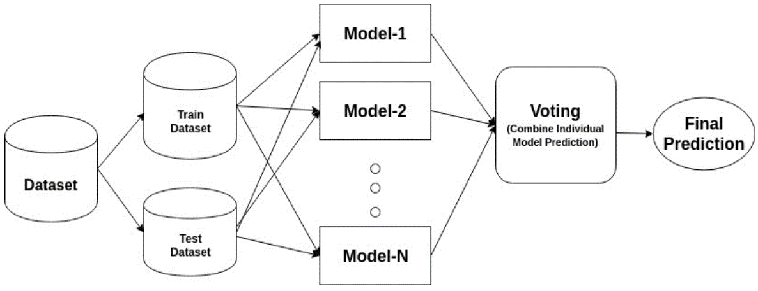
Image Detector – Models (Deep CNNs)
VGG16, VGG19 (https://arxiv.org/pdf/1409.1556.pdf)
ResNet50, ResNet101, ResNet152 (https://arxiv.org/pdf/1512.03385.pdf)
Xception (https://arxiv.org/pdf/1610.02357.pdf)
InceptionResNet (https://arxiv.org/pdf/1602.07261.pdf)
MobileNet (https://arxiv.org/pdf/1801.04381.pdf)
DenseNet (https://arxiv.org/pdf/1608.06993.pdf)
NASNet (https://arxiv.org/pdf/1707.07012.pdf)
Source: www.datacamp.com

Slide 16
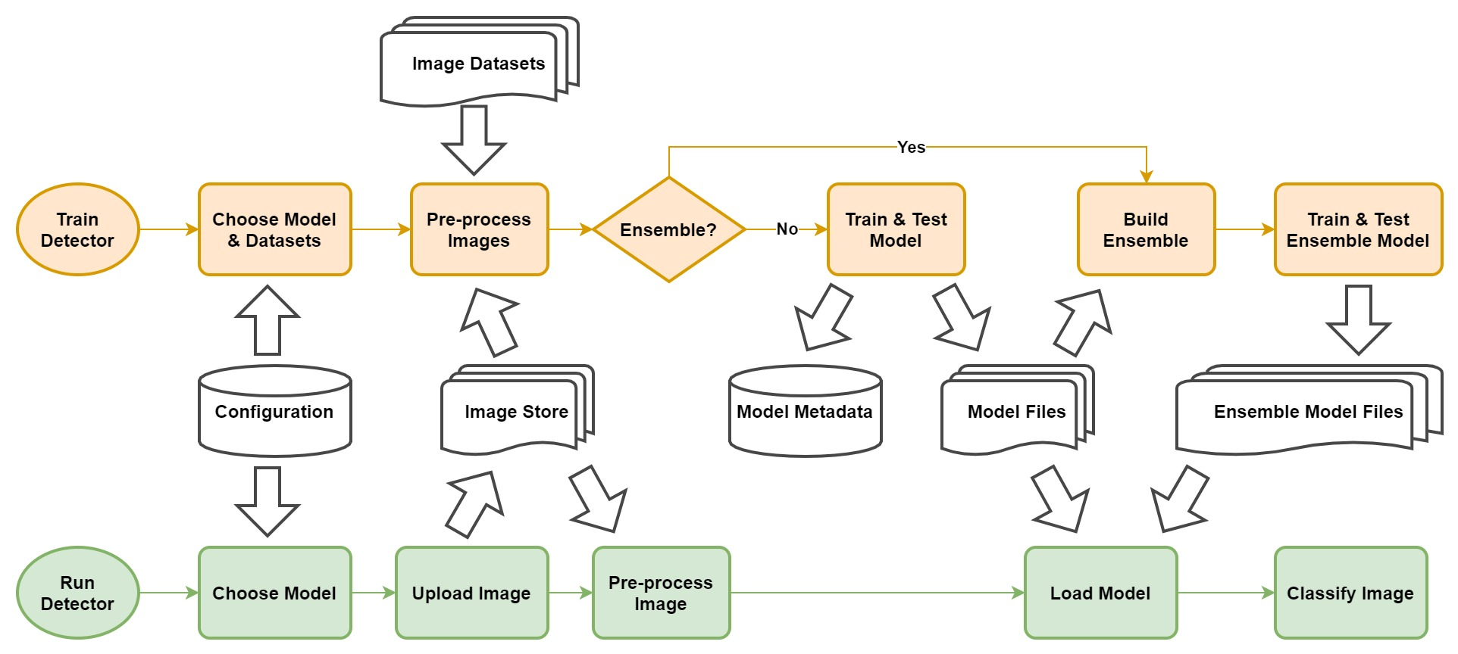
Image Detector – Process Design

Slide 17
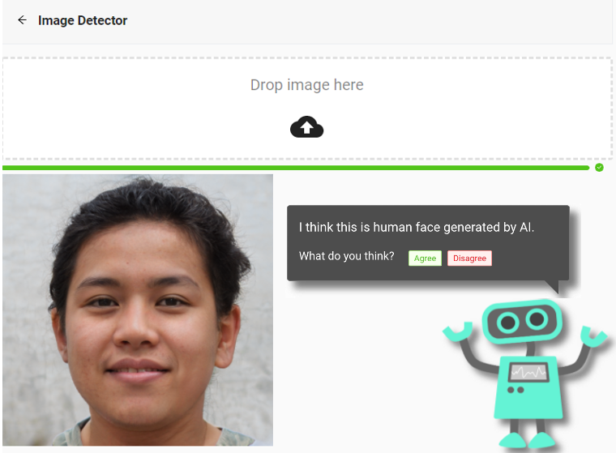
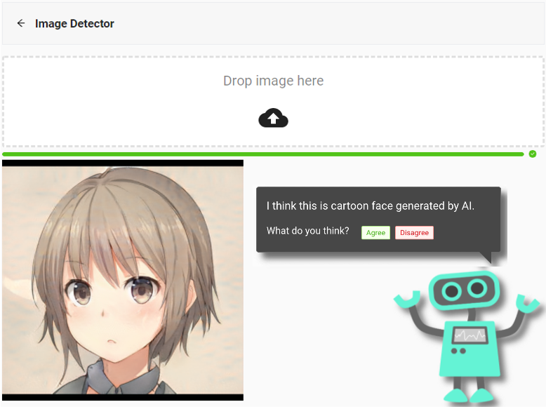
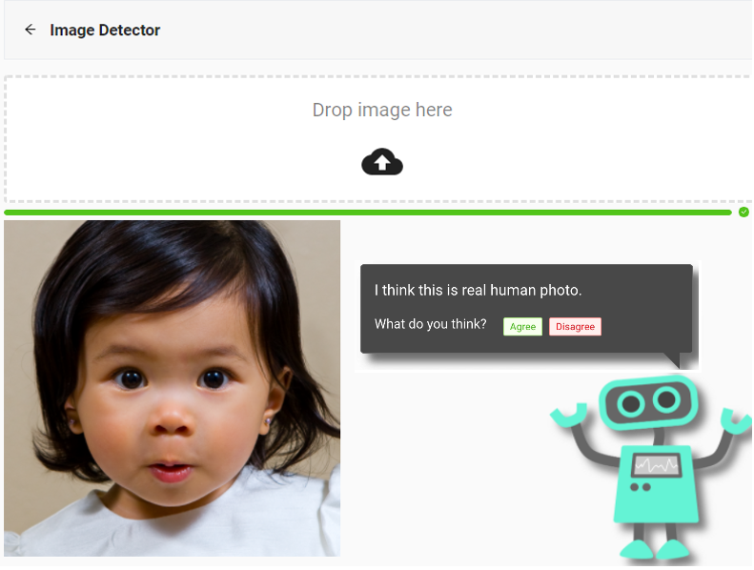
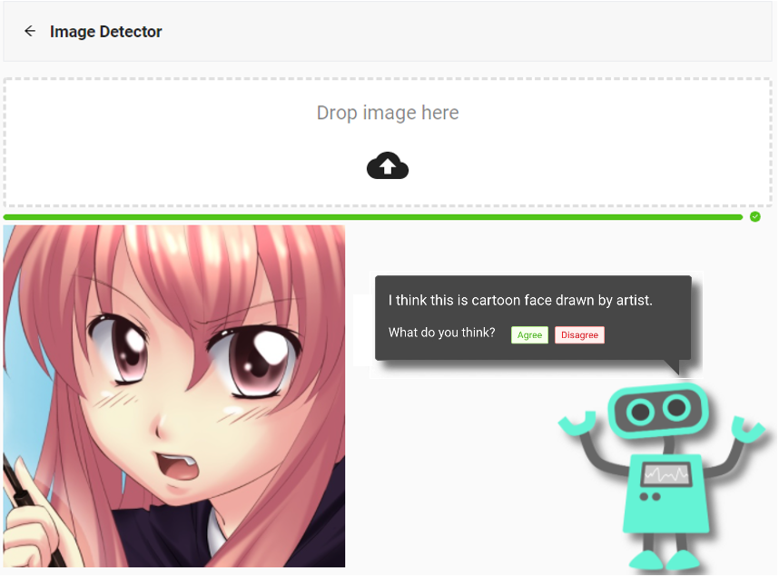
Image Detector – System Deployment
Fake
faces
Real
faces

Slide 18
Use Case Design
Use cases for image generator and detector are as below.
No. | Use Case | Functionality | User Input | System Output
1 | Virtual Human Facial Image Generator | End users are able to generate 10 number of random fake human faces each time. If needed, can generate more photos when click “+” button. | Users select AI-generated faces from drop list on Generator page. | A gallery view of human faces will show up on web UI, and user can download photos selectively or by batches.
2 | Virtual Cartoon Facial Image Generator | End users are able to generate 10 number of random fake cartoon faces each time. If needed, can generate more photos when click “+” button. | Users select AI-generated faces from drop list on Generator page. | A gallery view of cartoon faces will show up on web UI, and user can download photos selectively or by batches.
3 | Real/ Virtual Facial Photo Detector | End users upload a photo via web UI, and a robot will suggest whether the photo is real or AI-generated. | Users upload photos via a drop-down box on detector page. | Classification result will print on screen, possibly with explanations.
4 | Cartoon Face Detector | End users upload a photo via web UI, and a robot will suggest whether the photo is drawn by artists or AI-generated. | Users upload photos via a drop-down box on detector page. | Classification result will print on screen, possibly with explanations.
5 | Hybrid Models & User Feedback | Web UI displays different models (e.g. cartoon face (DCGAN), Asian face (StyleGAN) & celebrity face (StyleGAN) etc.) for users to select through enabled/ disabled them on optional box of Image Generator page. Users are allowed to mark and download favourite photos. | Users select single or mixed models from optional box to generate photos, mark and download any photos. | The following info will show up on web UI. 1) Types of models that generate images. 2) Users’ preference of different models. 3) The history of image downloads from each model.

Slide 19
Further Enhancement
After the system goes live, it will continue to collect valuable data that users uploading. Since those are most significant and useful data for application scenarios.
Re-run the training process periodically with both pre-collected dataset photos and user uploaded photos. Compare the results and replace models when there is improvement.
Search and identify other possible model definitions (e.g. from newly published papers). Try them out and add suitable models to the collection of saved models.

Slide 20
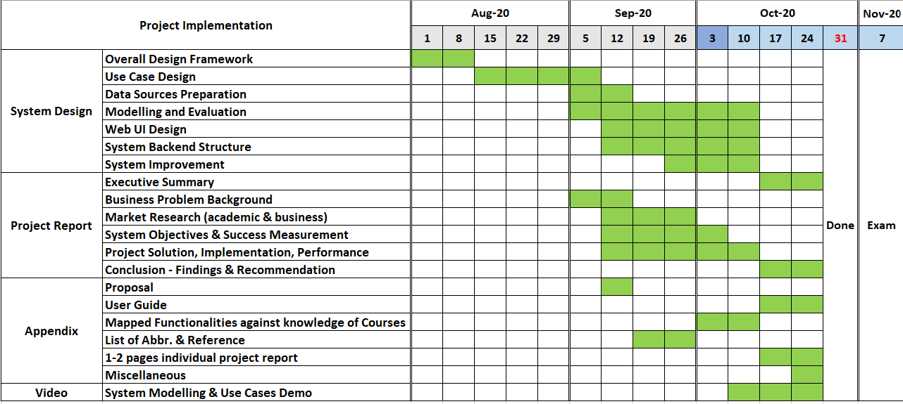
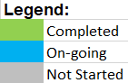
Progress Update on System Implementation
100% Completed

Slide 21
Q & A
THANK YOU

